Slide 1


Cluster
Krishno Dey
Lecturer
Department of Computer Science and Engineering

Slide 2
Agenda
What is Hadoop Cluster
Hadoop Cluster Architecture
Size of Hadoop Architecture
Single Node and Muti-Node Cluster
Communication Protocol in Hadoop Cluster
Benefits of Hadoop Cluster
Challenges of Hadoop Cluster

Slide 3

What is Cluster
A Hadoop cluster is a collection of computers, known as nodes, that are networked together to perform parallel computations on big data sets.
Hadoop clusters consist of a network of connected master and slave nodes that utilize high availability, low-cost commodity hardware.

Slide 4
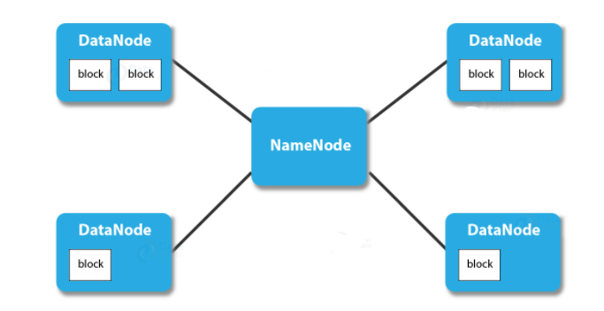
Hadoop Cluster Architecture
Hadoop cluster has master-slave architecture.
Master in Hadoop Cluster
Slaves in Hadoop Cluster

Slide 5
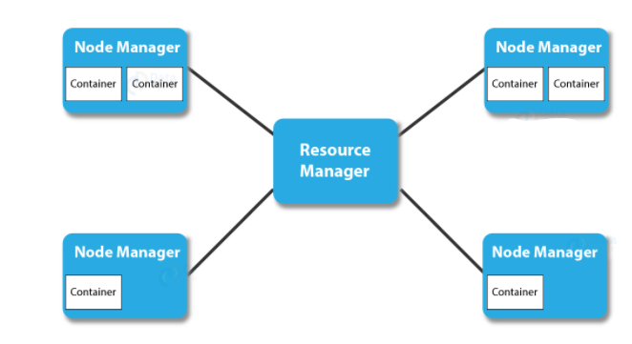
Hadoop Cluster Architecture
Master in Hadoop Cluster Consists of
NameNode
Resource Manager

Slide 6
Hadoop Cluster Architecture
Slave in the Hadoop Cluster Consists of
DataNode
NodeManager
Client Node

Slide 7
Single Node Cluster
Consist of only one node.
All the NameNode, DataNode, ResourceManager, and NodeManager are on a single machine.
Only one DataNode is running.
Mainly used for studying and testing purposes

Slide 8
Multi-Node Cluster
Consist of multiple node.
Daemons run on separate host or machine.
NameNode daemon run on the master machine
DataNode daemon runs on the slave machines.
Used in organizations for analyzing Big Data.

Slide 9
What is cluster size in Hadoop?
A Hadoop cluster size is a set of metrics that defines storage and compute capabilities to run Hadoop workloads, namely :
Number of nodes : number of Master nodes, number of Edge Nodes, number of Worker Nodes.
Configuration of each type node: number of cores per node, RAM and Disk Volume.

Slide 10
Calculating Hadoop Cluster Capacity
For example: Let's say that you need 500TB of space. If you have a JBOD of 12 disks, and each disk can store 6TB of data, then the data node capacity, or the maximum amount of data that each node can store, will be 72 TB. Data nodes can be added as the data grows, so to start with its better to select the lowest number of data nodes required.
In this case, the number of data nodes required to store 500TB of data equals 500/72, or approximately 7.

Slide 11
Communication Protocols Used in Hadoop Clusters
The HDFS communication protocol works on the top of TCP/IP protocol.
The client establishes a connection with NameNode using configurable TCP port.
Hadoop cluster establishes the connection to the client using client protocol.
DataNode talks to NameNode using the DataNode Protocol.

Slide 12
Benefits of Hadoop Clusters
Robustness
Data disks failures, heartbeats and re-replication
Cluster Rebalancing
Data integrity
Metadata disk failure
Snapshot

Slide 13
What are the challenges of a Hadoop Cluster?
Issue with small files
High processing overhead
Only batch processing is supported
Iterative Processing

Slide 14
References
Data-Flair
Data-Bricks

